Slide 1
Variable Creation from Transactional Data for Supervised Learning.
Satish Kumar Simhadri - Director Data Science - Rang Technologies Inc
Amit Lal – Senior SAS Programmer, Novartis (Rang Technologies Inc)

Slide 2
Agenda
What is supervised learning
What kinds of data is used
Taking variables ( independent and dependent) from observation window and performance window.
Motivation: Applications.
Same process – multiple industries.
How the data looks like ?
Explaining code

Slide 3
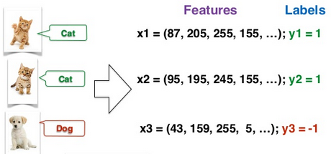
Supervised Learning

Slide 4

supervised learning

Slide 5
Supervised Learning
Data
Features and Labels
Model
Labels
New data

Slide 6





What is Event/Label ?

Slide 7
How we get the features
Transactional Data ( multiple records )
Claims or transactions of credit card
Demographic Data( Single record)
Demographic information of
3rd party data
Lexus Nexus
CMS data
Axiom
Patient/Provider
Customer/Merchant
Customer/Merchant
Patient / Provider

Slide 8
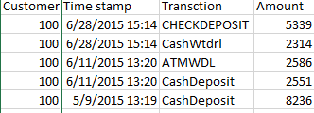
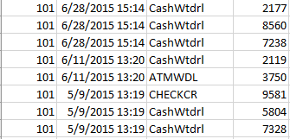
Transactional data
Looks similar for retail, banking, health care, media and many other industries

Slide 9
Creating features
Observation window
Performance window
Feb 2016
Feb 2017
Aug 2017

Slide 10
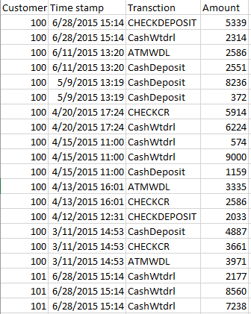
Feature creation
Average
Minimum
Maximum
Counts
Balance

Slide 11
Explaining Code
Convert raw file from text or csv file format to SAS dataset
%csvtxt2sas(out=bankdata , in=%str('C:\Users\HP\Desktop\sugi17\Bank transactional data.csv'), delimit=%str(',') );
Notes:
1- First we convert the raw file which can be txt or csv to sas dataset. We have used csv file for this example. I am using macro csvtxt2sas to convert the csv file to sas dataset.

Slide 12
Explaining Code
Data preparation
amount = input(amount_,best.) ;
trandate = input(scan(time_stamp,1,''),mmddyy10.);
Duration macro
%duration(dsinmain= ,trandate= , keyvar= ,mon= );
Notes:
Data preparation
We are going to calculate statistics on the data and also we want to look into data with different time window or time duration. In the example we are preparing data to make sure that amount has numeric value. Also, the date on which these transactions took place should be numeric .
Duration macro
The program has been designed to calculate duration in months. For example if we want one year data then we can pass value 12 in macro to get one year data. Similarly , we can get half yearly data by passing value 6 or 2 years data with passing value 36 in the macro.

Slide 13
How autobank macro works
Parameters :
dsinmain stat1 stat2 stat3 stat4 stat5 nstat keyvar month trandate
Notes:
Parameters of autobank macro:
**dsinmain=name of the main input dataset
**stat1 = first summary statistics
**stat2 = second summary statistics
**stat3 = third summary statistics
**stat4 = fourth summary statistics
**stat5 = fifth summary statistics
**nstat = total number of statistics we want to calculate.If we want to process stat1 to stat3 then
** nstat will be 3, if stat1 to stat5 then nstat will be 5 *
**keyvar= key variable in the data for example: customer id in case of bank data
**month = months for which we want to calculate the statistics. The values should be sepeated by ***
** blank space. For example - month = 1 2 3 or month= 3 6 ***
**trandate = numeric value of date in the main input dataset, time part not attached to date ***

Slide 14
How autobank macro works
Subsets input datasets into different time duration based on requirements.
Notes:
We can pass value to the macro parameter month and the macro will automatically subset main dataset based on our requirement. If we want statistics for third month and sixth month then we can pass value 3 6. Similarly for first 10th and 12th month we should pass value 1 10 12.

Slide 15

How autobank macro works
Capture different transactions in the data.
Calculate different statistics for each transactions .
Notes:
The data we used have these transactions: ATMWDL,CHECKCR,CHECKDEPOSIT,CashDeposit,CashWtdr
In sample code we want to calculate sum, min, max, count and average of these transaction. Bank macro inside the autobank macro accomplish this step
We use transaction macro inside autobank macro to arrange the data in horizontal format. Parmbuff option was used in transaction macro to dynamically pass value the macro.
%do %while loop was used inside autobank macro to further consolidate the data in horizontal form for different statistics or all transaction for different time periods.

Slide 16


How autobank macro works
Get horizontal data – different statistics of all transaction of one time period
Further consolidate data - different statistics of all transaction for different time periods.
Notes:
We use transaction macro inside autobank macro to arrange the data in horizontal format. Parmbuff option was used in transaction macro to dynamically pass value the macro.
%do %while loop was used inside autobank macro to further consolidate the data in horizontal form for different statistics or all transaction for different time periods.

Slide 17
Code is available at
https://github.com/simhadri1/With-Amit-Lal-on-Variable-creation
Notes:
We use transaction macro inside autobank macro to arrange the data in horizontal format. Parmbuff option was used in transaction macro to dynamically pass value the macro.
%do %while loop was used inside autobank macro to further consolidate the data in horizontal form for different statistics or all transaction for different time periods.

